Slide 1
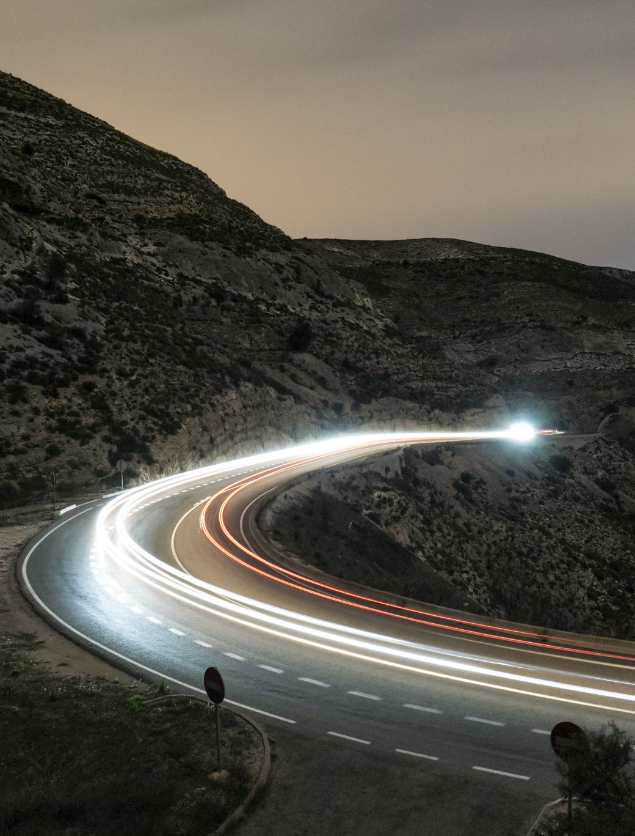
Driver Drowsiness Detection
Onasvee Banarse
Kaustubh Kabra
Himanshu Bendale
Vincent Simon
Harsh Shah

Slide 2
What is Driver Drowsiness?
Feeling abnormally sleepy or tired during the day is commonly known as drowsiness. Drowsiness may lead to additional symptoms, such as forgetfulness or falling asleep at inappropriate times.
Drowsiness makes a person sleepy during inappropriate situations or inappropriate time.
Drowsiness of a driver is extremely dangerous as he loses the control of the vehicle which risks many lives.
It is the root cause of majority of the road accidents.

Slide 3
Causes of Driver Drowsiness
Sleep deprivation: Lack of sleep is a leading cause of excessive daytime sleepiness, which can induce micro sleeps or other dangerous driving behavior. Adults should get between seven and nine hours of sleep each night, but a significant number of adults routinely fail to get this recommended amount of sleep.
Alcohol: Drinking alcohol can prompt sleepiness while also affecting reaction time and decision-making in ways that increase the risks of auto accidents.
Time of day: Auto accidents from drowsy driving occur most frequently between midnight and six a.m. or in the mid-afternoon, which are two times when sleepiness peaks.

Slide 4
Impact of Driver Drowsiness
Every year the amounts of deaths and injuries are increasing in traffic accidents due to human errors.
If the Driver failing to concentration on driving it reduces the driver reaction time and impair steering behavior.
We often hear of drunken driving, no seat belt, speeding, road condition, bad weather and mechanical failures. But one of the biggest and yet often unrecognized human errors is drowsy driving. A major problem not only in India but across the globe. The risk, danger, and often tragic results of drowsy driving are alarming indeed. Obviously lack of sleep is the main culprit.
Falling asleep at the wheel is suicidal. It is not only dangerous to the driver but to all other road users. It certainly jeopardizes the safety.
Exhausted drivers who doze off at the wheel are responsible for about 40% of road accidents, says a study by the Central Road Research Institute (CRRI) on the 300-km Agra-Lucknow Expressway. The finding rings the alarm bell on how Indian highway motorists ignore the importance of taking adequate rest and end up endangering lives.

Slide 5
Signs for a rest
Some signs which indicate that you should rest or take a break while driving are
Drooping eyelids
Yawning repeatedly or rubbing eyes
Blurry vision
Nodding head
Drifting from lane
Not able to concentrate
Instead of taking a chance, the person driving the vehicle should pull off, wash his/her face or take a nap in the vehicle if possible.

Slide 6
Environment used
Our project will be implemented with python as a programming language.
Some of the packages used are-
OpenCV
dlib
Numpy
Keras
Imulits
Scipy
Math
OS

Slide 7
OpenCV NumPy
OpenCV (Open Source Computer Vision Library) is a library of programming functions mainly aimed at real-time computer vision.
It was originally developed by Intel
It will be used for facial and emotion recognition.
NumPy is a library for the Python programming language, adding support for large, multi-dimensional arrays and matrices, along with a large collection of high-level mathematical functions to operate on these arrays.
In our project we will keep track of the facial coordinates using the NumPy package as it contains powerful tools to operate on the coordinates.

Slide 8
Keras Imulits
Keras is an open-source software library that provides a Python interface for artificial neural networks.
Keras contains numerous implementations of commonly used neural-network building blocks such as layers, objectives, activation functions, optimizers, and a host of tools to make working with image and text data easier to simplify the coding necessary for writing deep neural network code.
Imutils are a series of convenience functions to make basic image processing functions such as translation, rotation, resizing, skeletonization, and displaying Matplotlib images easier with OpenCV.
OpenCV can be a big, hard to navigate library, especially if you are just getting started learning image processing. So therefore, imulits helps you to work on images conviniently.

Slide 9
SciPy Math
SciPy is a free and open-source Python library used for scientific computing and technical computing.
SciPy contains modules for optimization, linear algebra, integration, interpolation, special functions, FFT, signal and image processing, ODE solvers and other tasks common in science and engineering.
The math package is used to perform mathematical operations or tasks on the coordinate system provided by the dlib package.

Slide 10
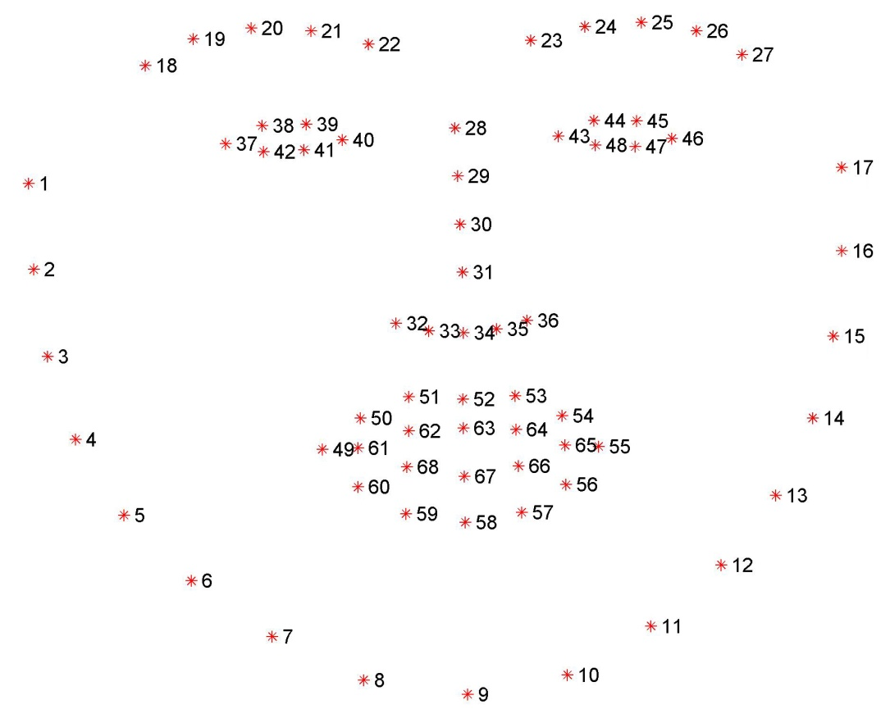
dlib
It‘s a landmark’s facial detector with pre-trained models, the dlib is used to estimate the location of 68 coordinates (x, y) that map the facial points on a person’s face like image below.
These points are identified from the pre-trained model

Slide 11
Thank You

